Slide 1

Digital Logic Design

Slide 2
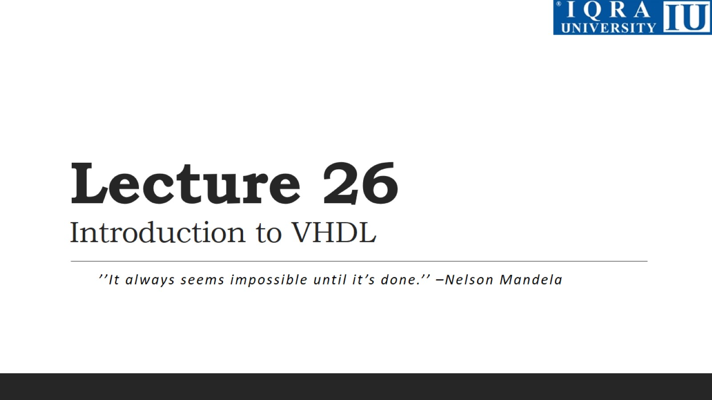
Lecture 26 Introduction to VHDL

Slide 3
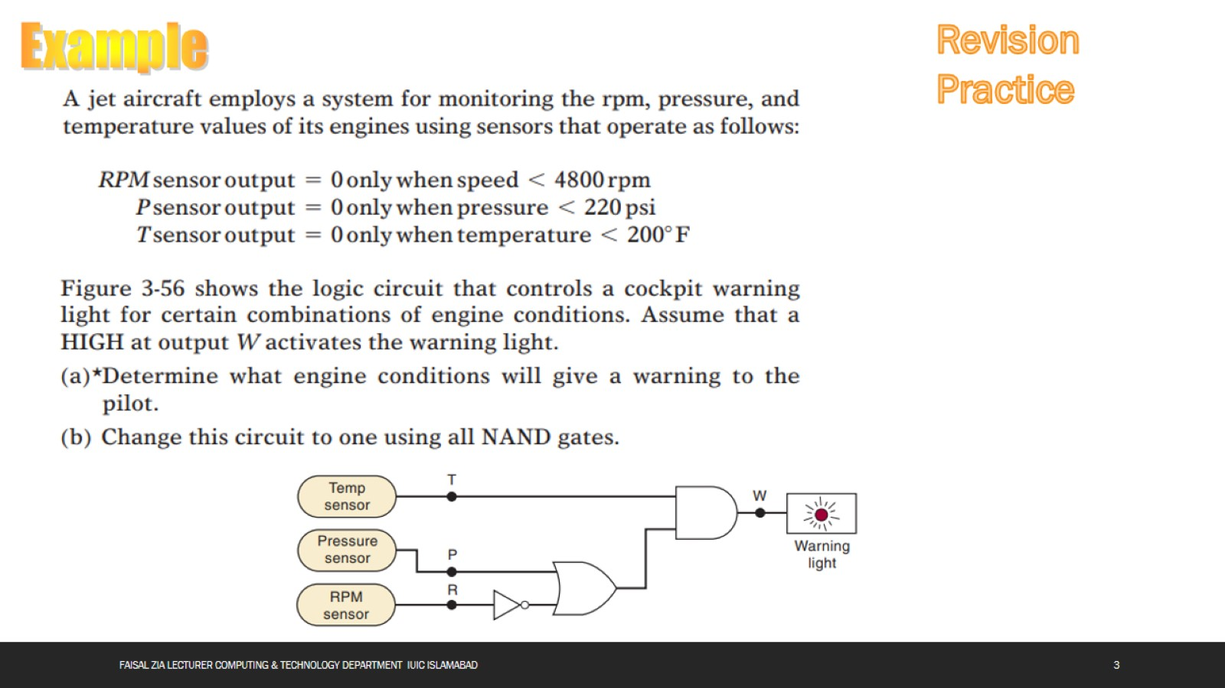

Slide 4
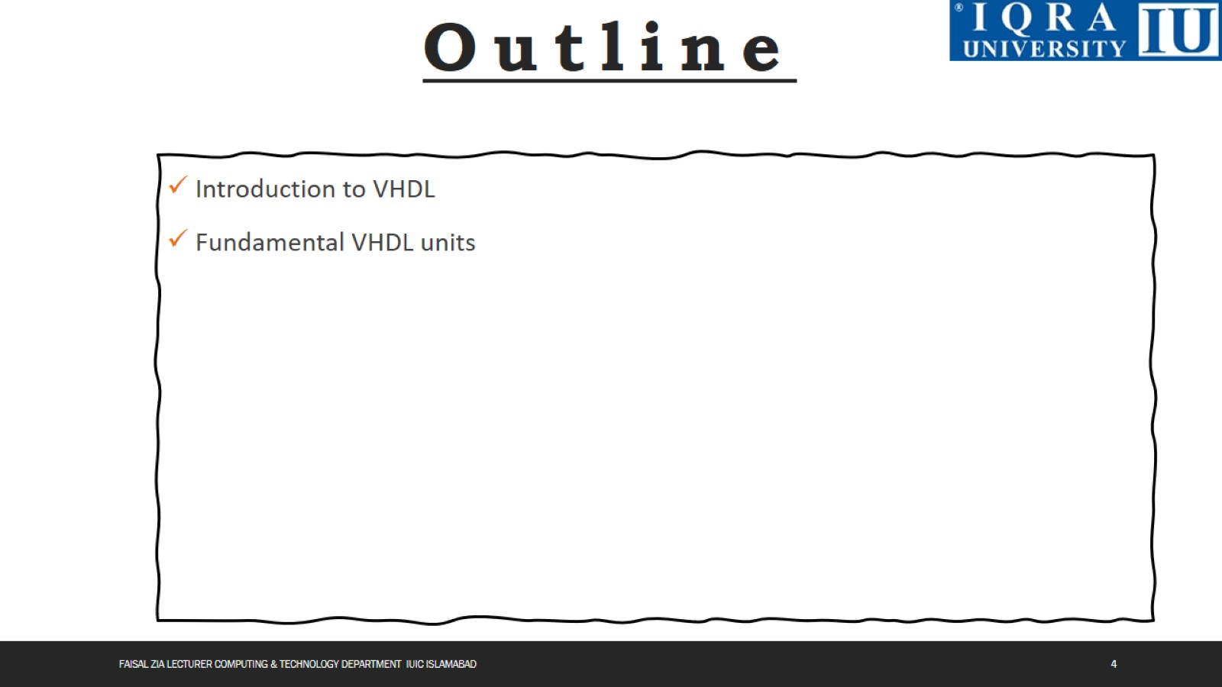

Slide 5
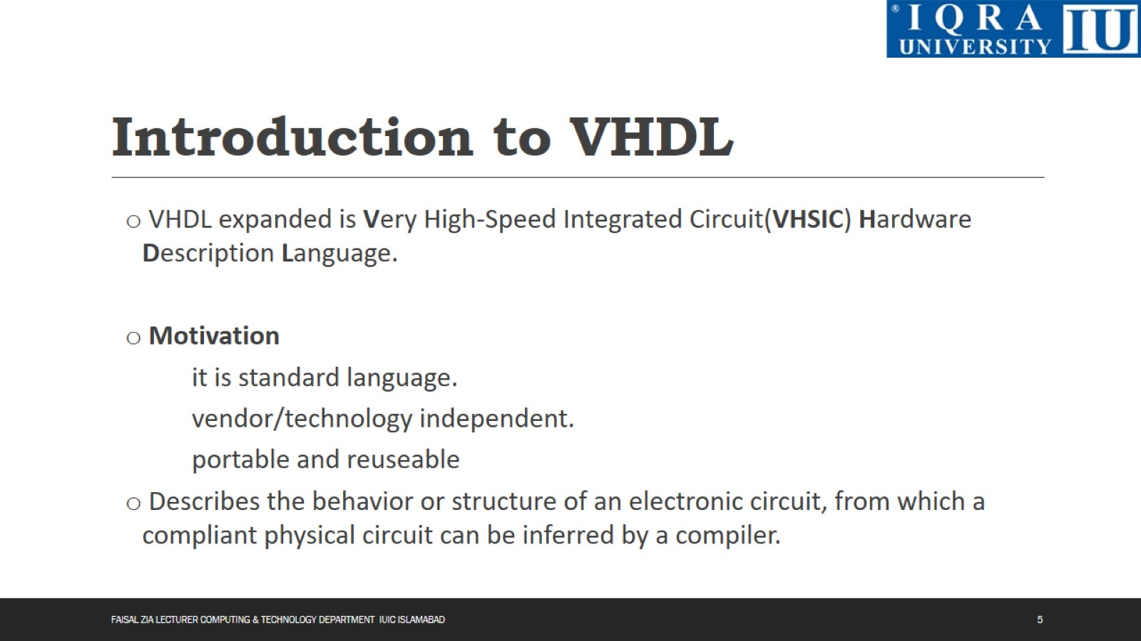
Introduction to VHDL

Slide 6
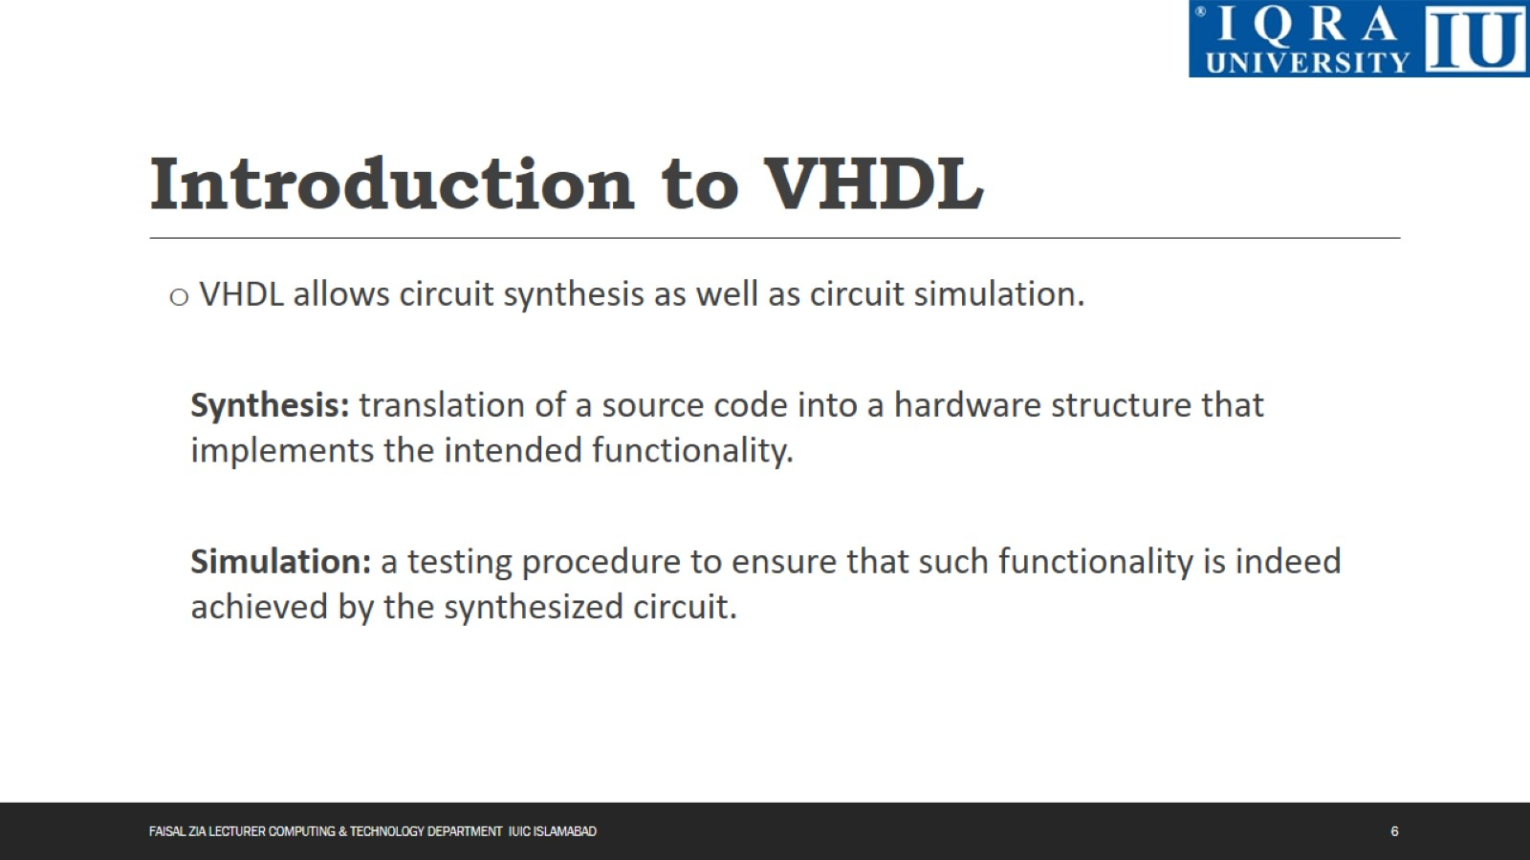
Introduction to VHDL

Slide 7
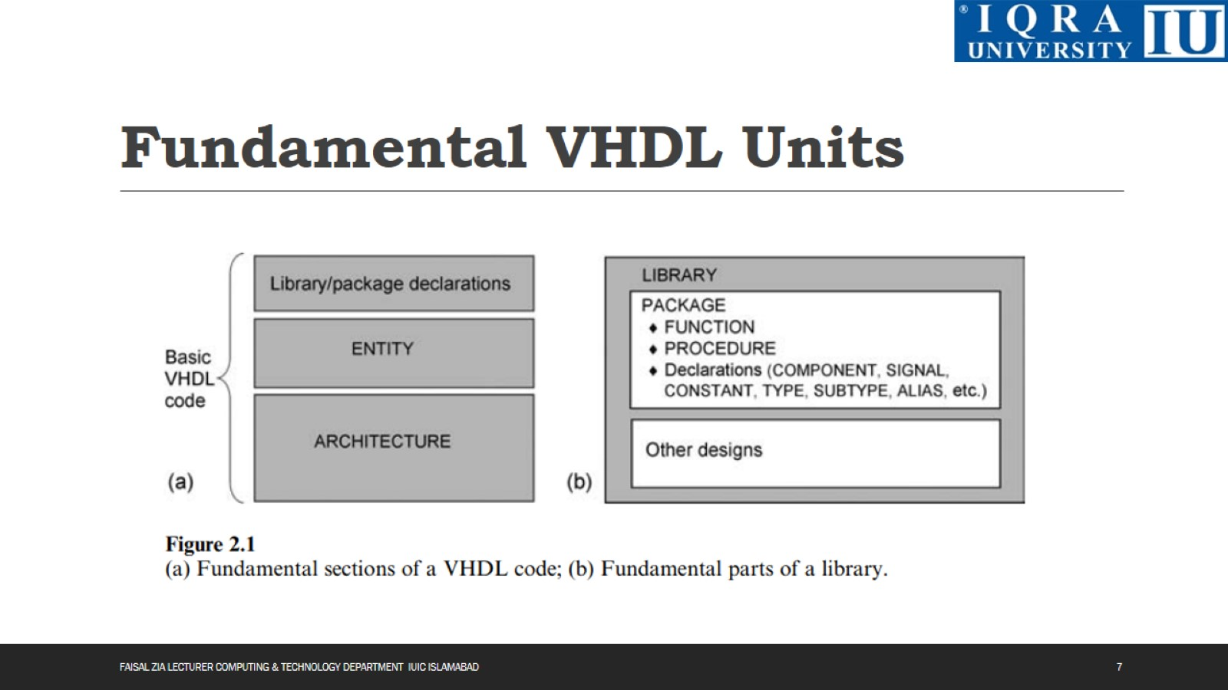
Fundamental VHDL Units

Slide 8
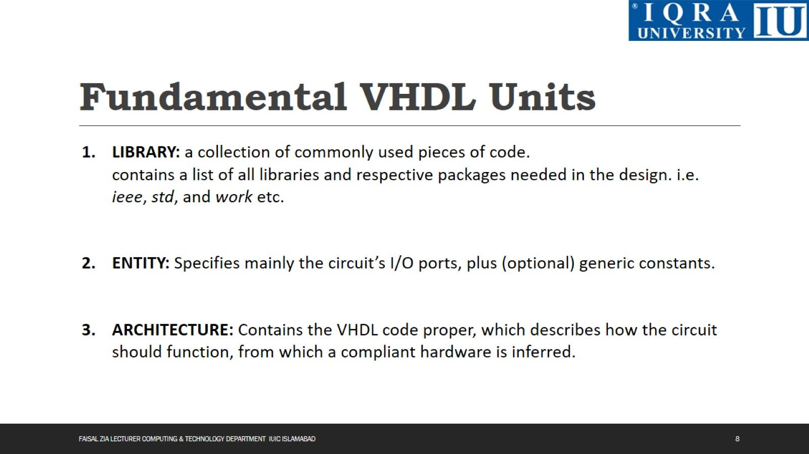
Fundamental VHDL Units

Slide 9
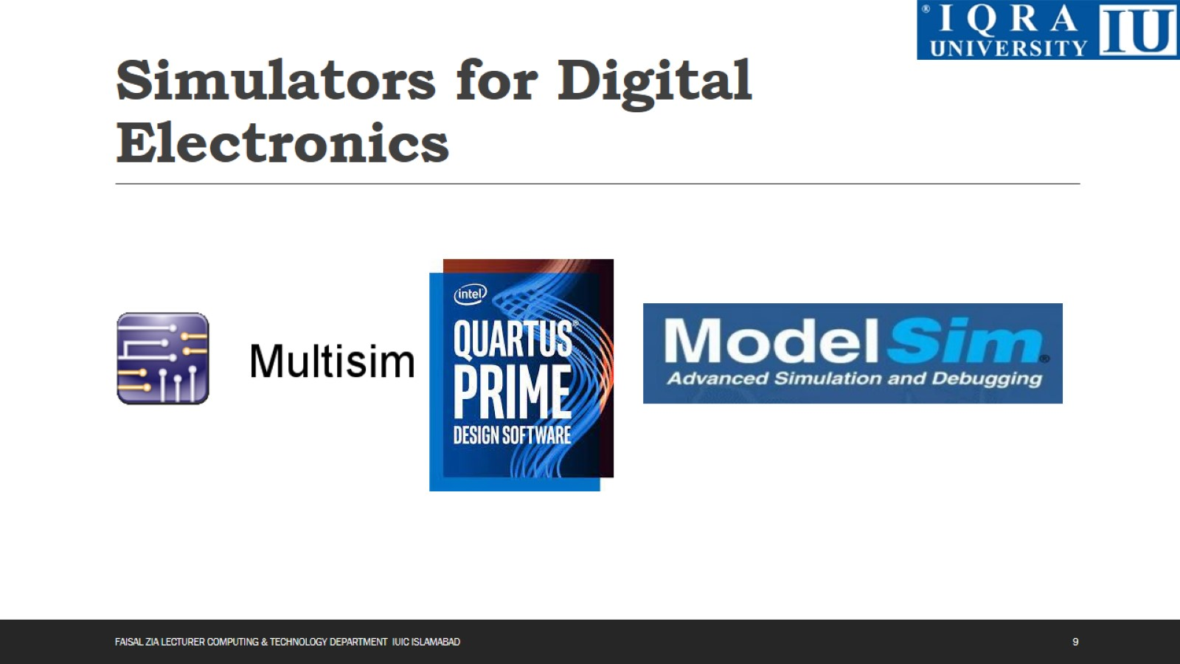
Simulators for Digital Electronics

Slide 10
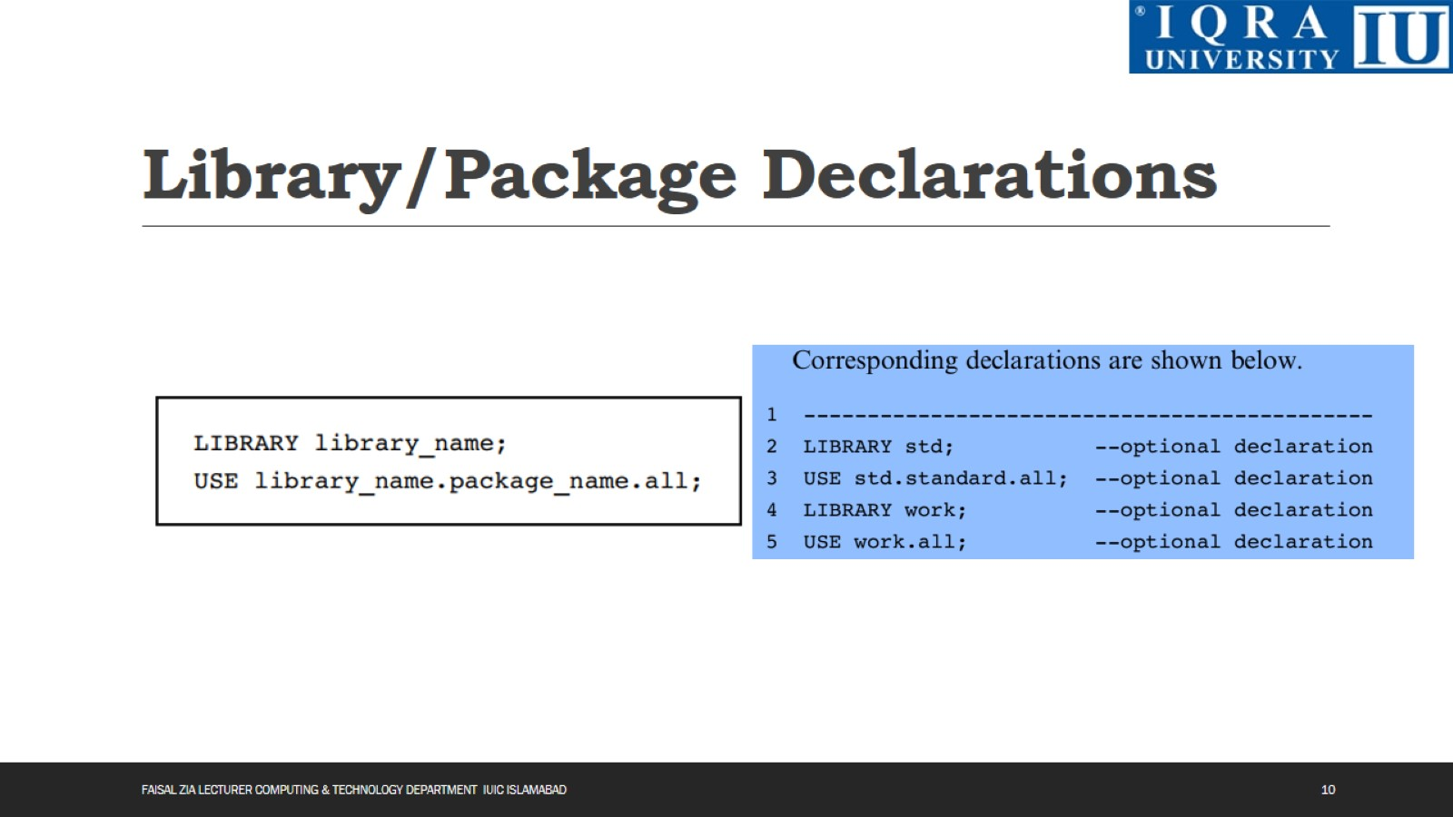
Library/Package Declarations

Slide 11
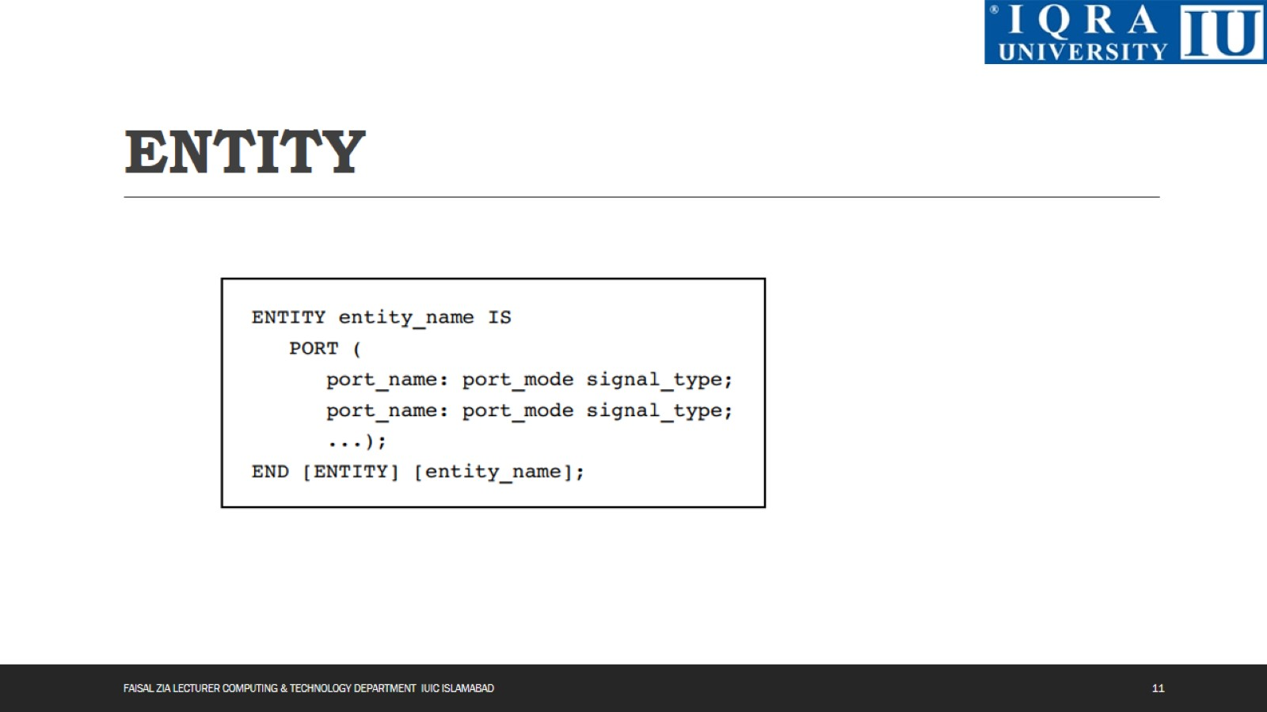
ENTITY

Slide 12
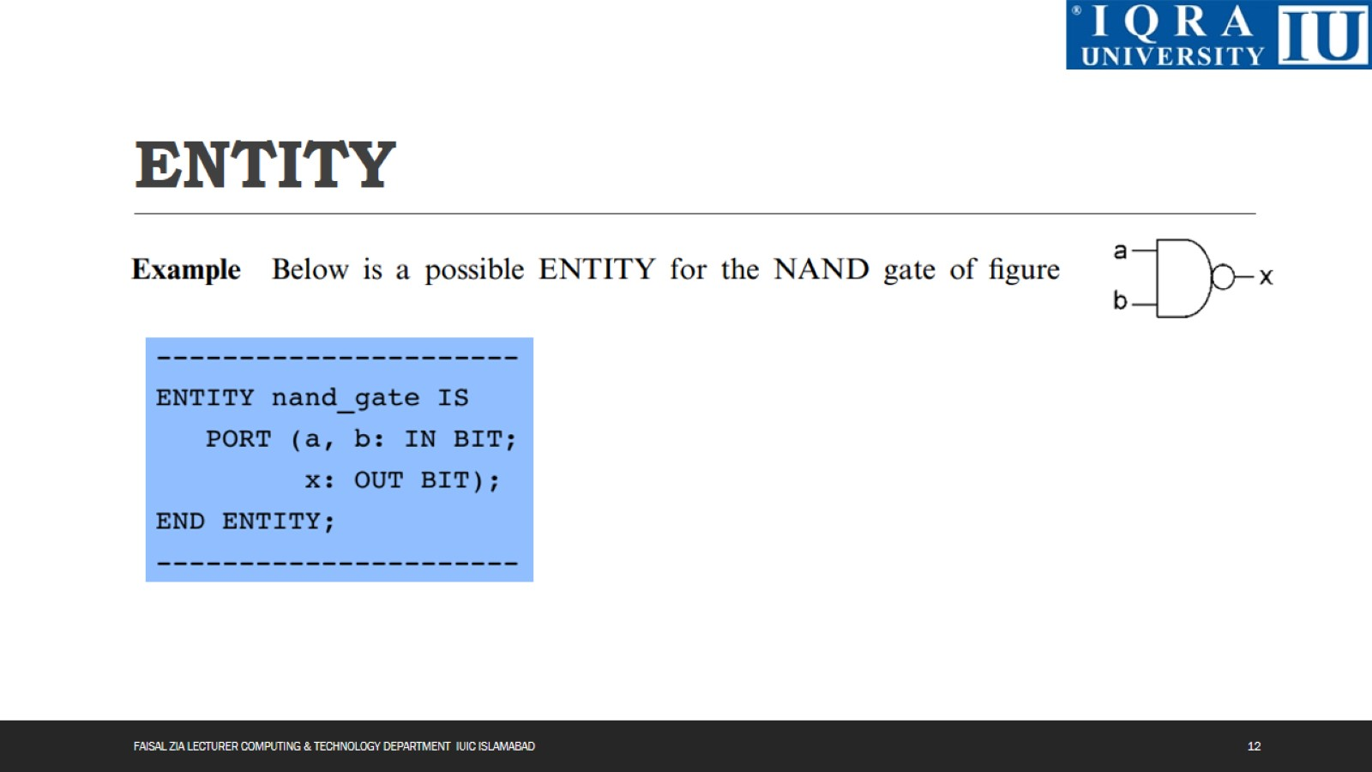
ENTITY

Slide 13
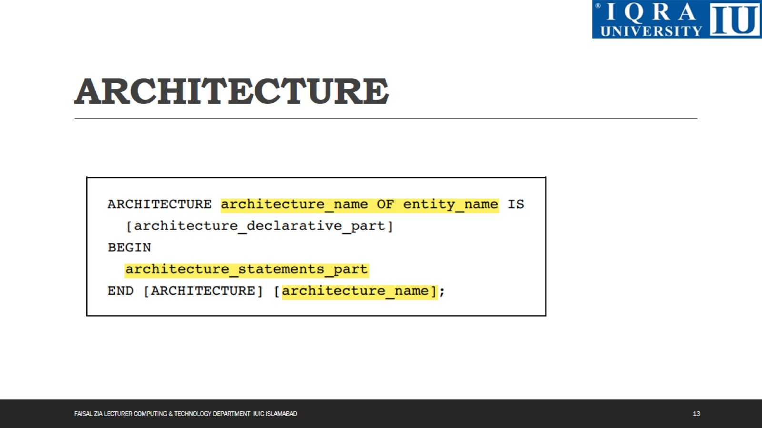
ARCHITECTURE

Slide 14
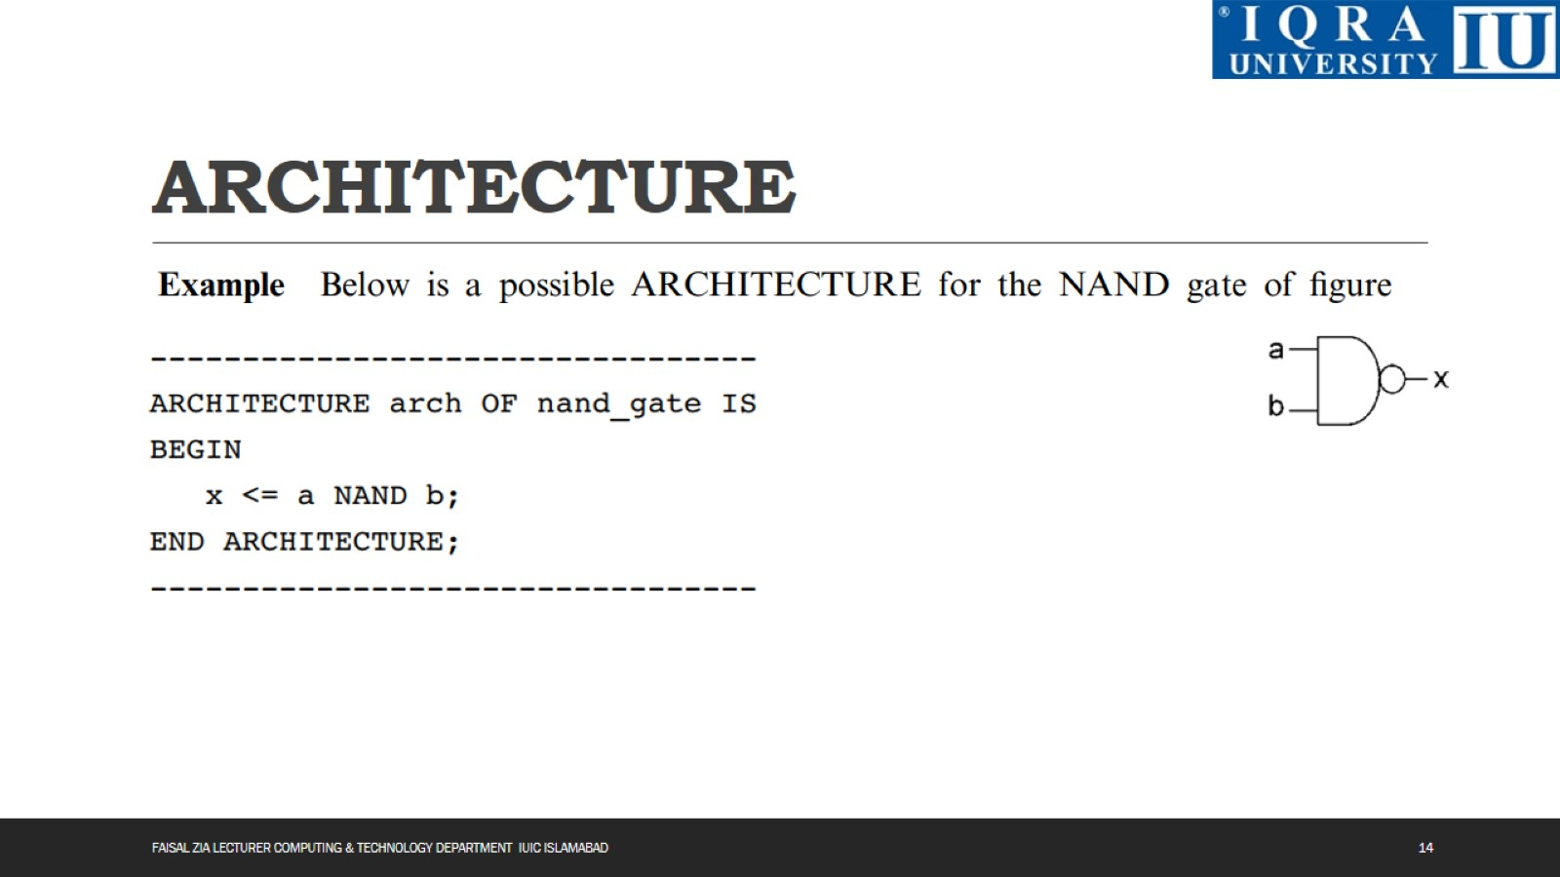
ARCHITECTURE

Slide 15
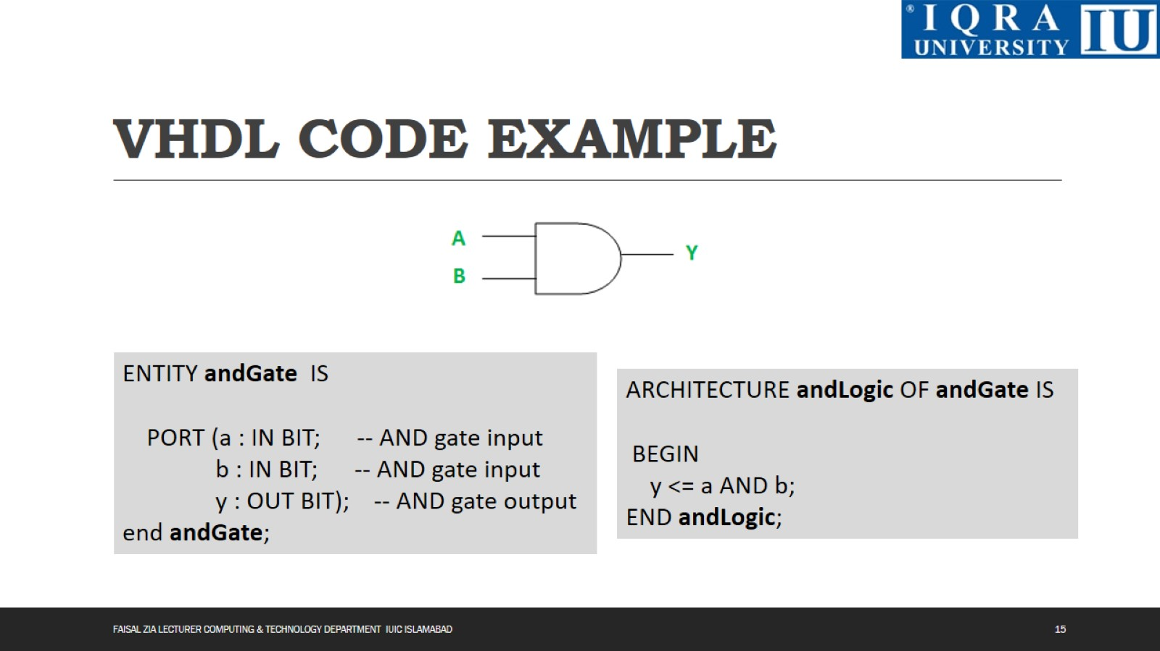
VHDL CODE EXAMPLE

Slide 16
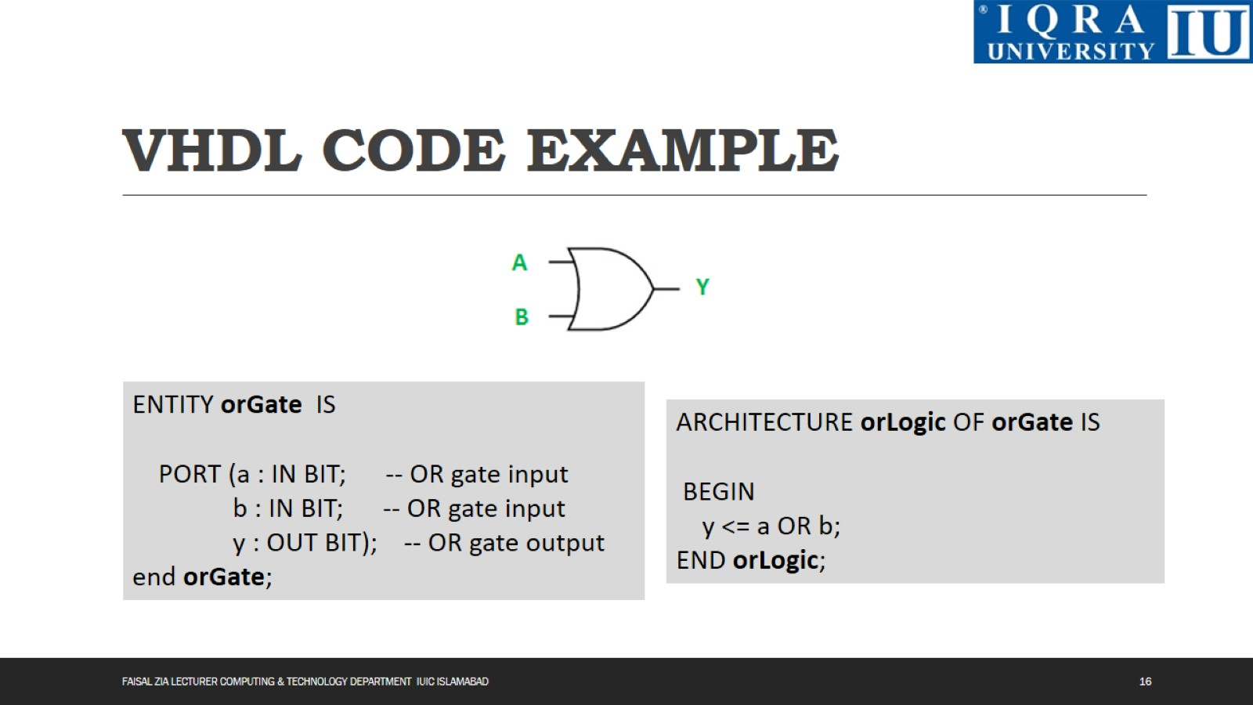
VHDL CODE EXAMPLE

Slide 17
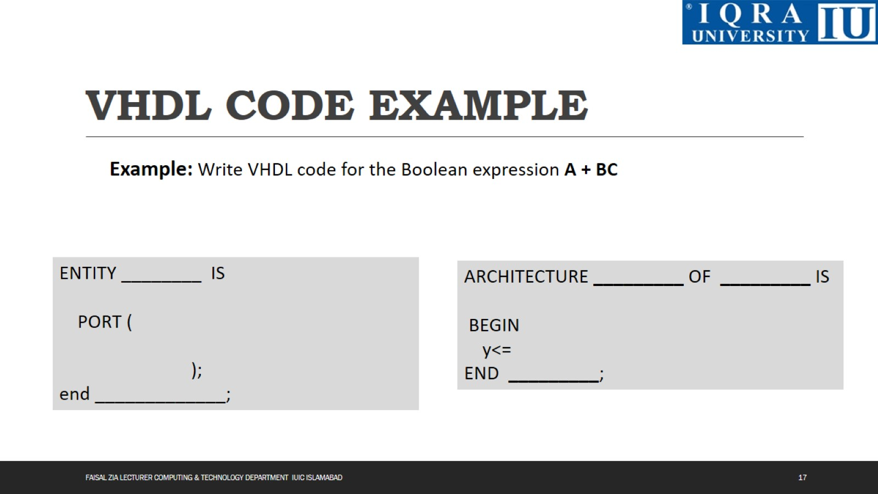
VHDL CODE EXAMPLE

Slide 18
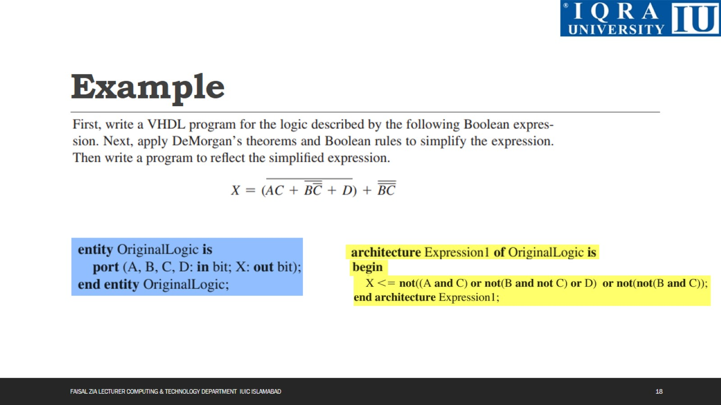
Example

Slide 19
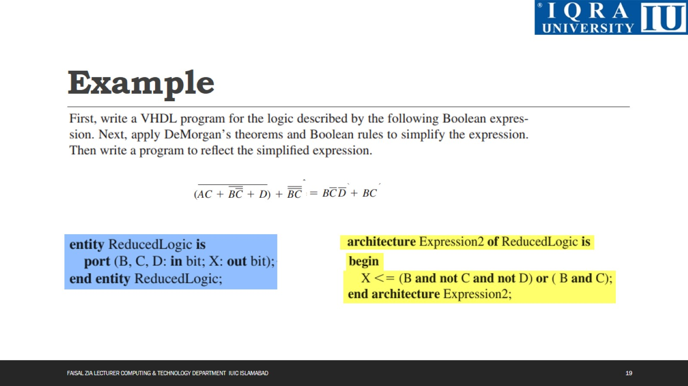
Example

Slide 20
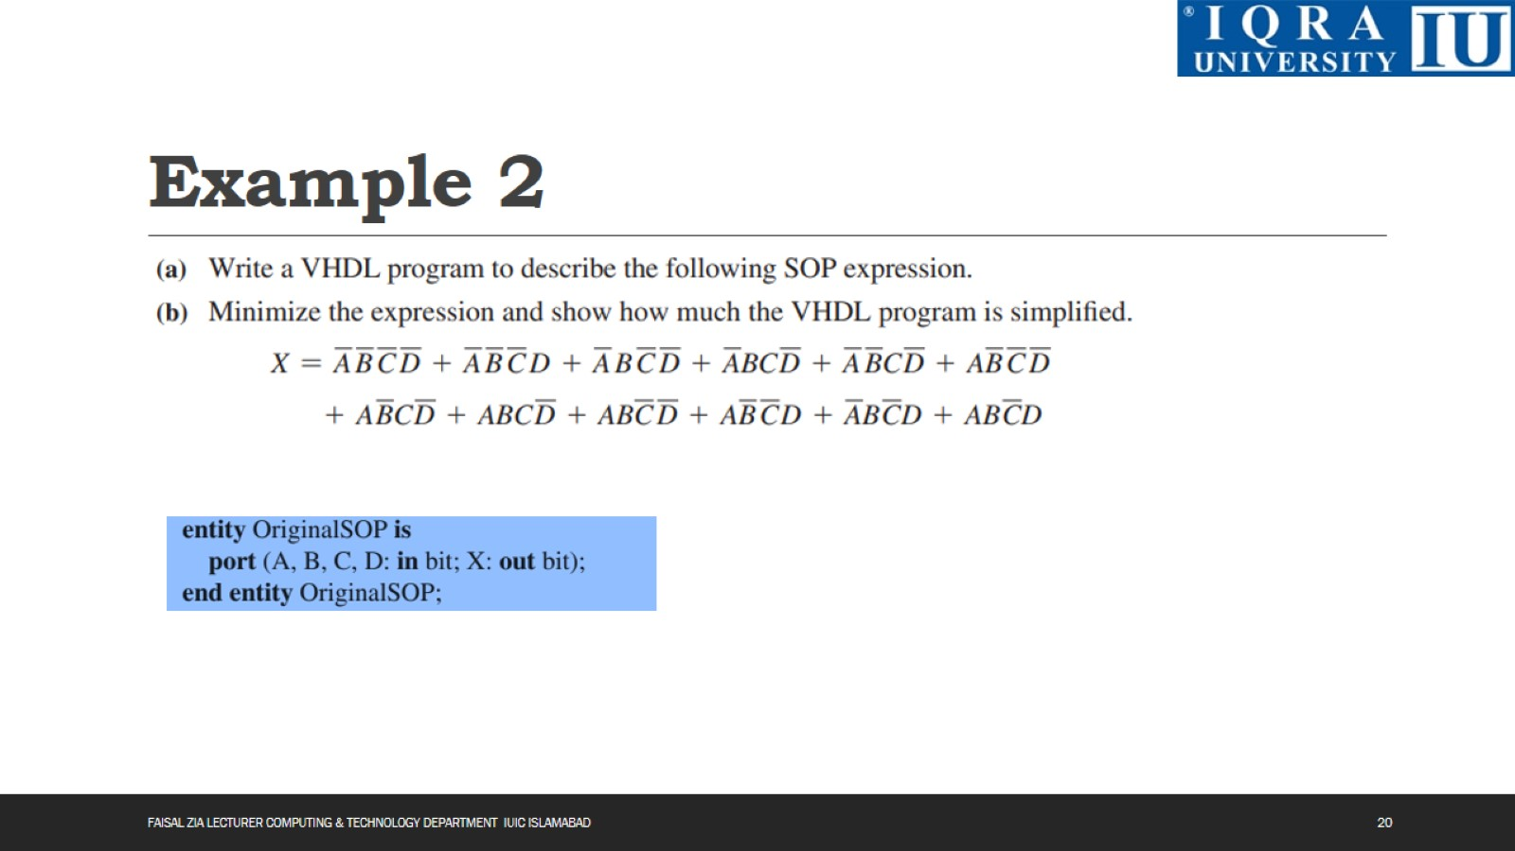
Example 2

Slide 21
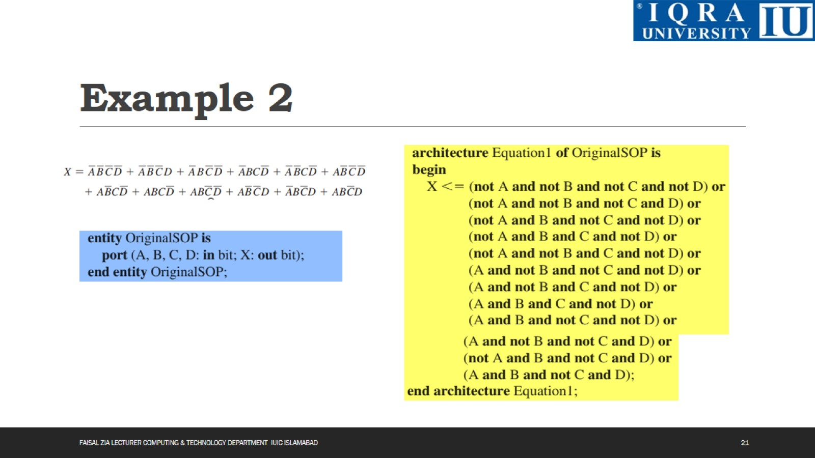
Example 2

Slide 22
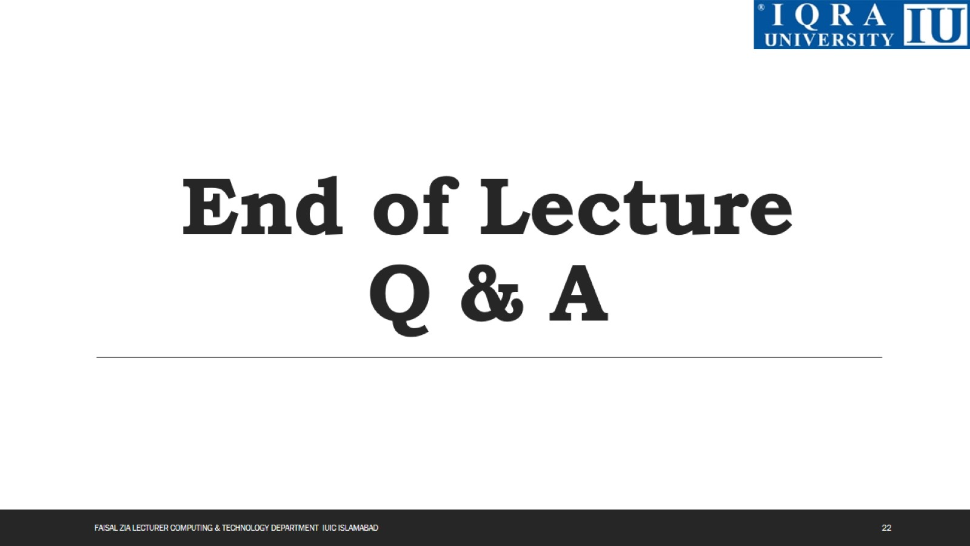
End of Lecture Q & A

